Slide 1
610 Big Data Analytics Final Project
Sentimental Analysis
By Group 1
Riya
Pavani
Bandana
Charan

Slide 2
Data Set used : Amazon Product review data. Arts, Crafts & Sewing
Tool Used : Google Colab
Topic : Sentiment analysis studies the subjective information in an expression, that is, the opinions, appraisals, emotions, or attitudes towards a topic, person or entity. Expressions can be classified as positive, negative, or neutral. For example: “I really like the new design of your website!” → Positive
Here we are doing a sentimental analysis on Amazon reviews meta data(Arts, Crafts and Sewing Dataset).

Slide 3
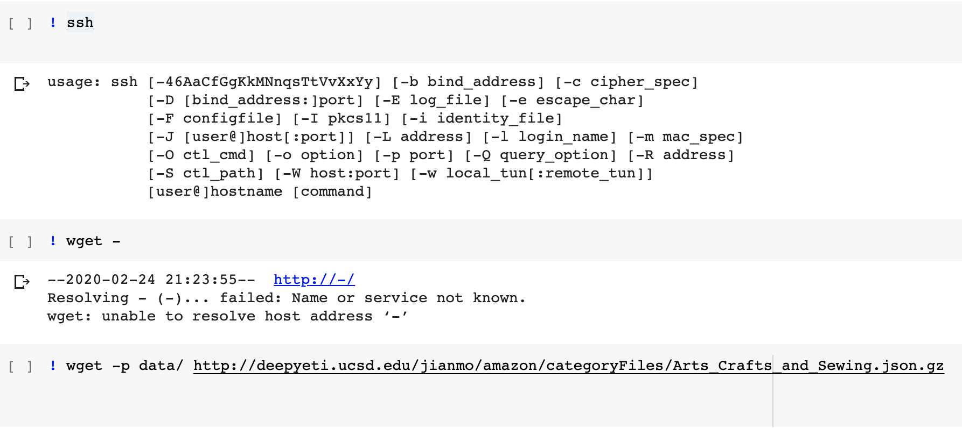
In order to perform Sentimental Analysis here we are going to discuss what are the necessary steps required:
1.) Creating a spark environment in Google Colab and installing pyspark.

Slide 4
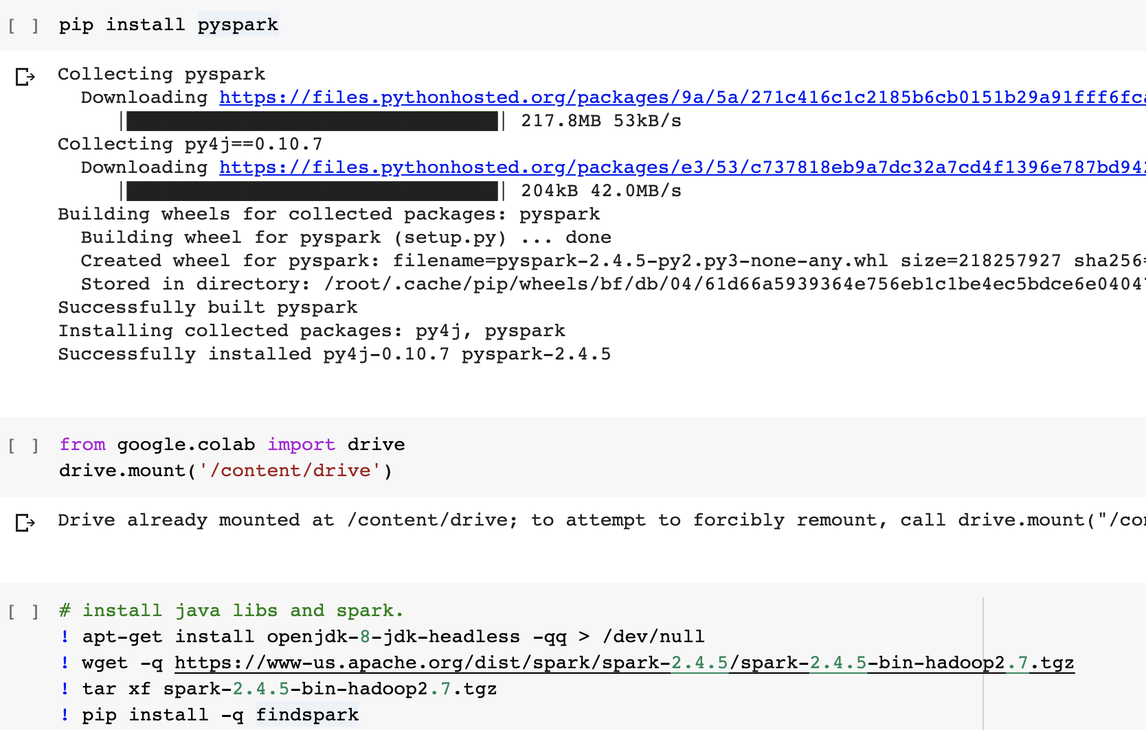

Slide 5
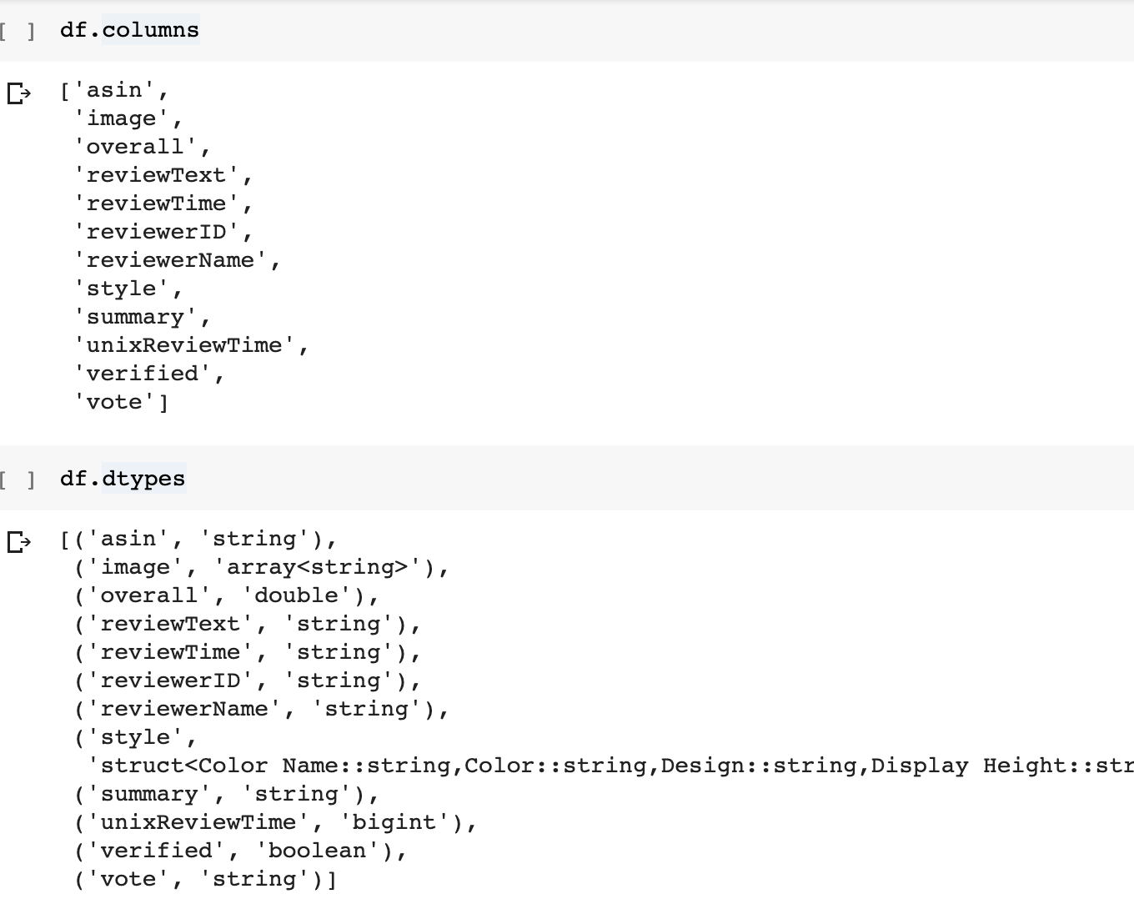
2.) Exploratory Data Analysis where we have performed several tasks like: - Extracting data into colab, reading the data and understanding the basic information like columns, datatypes, finding null values.

Slide 6
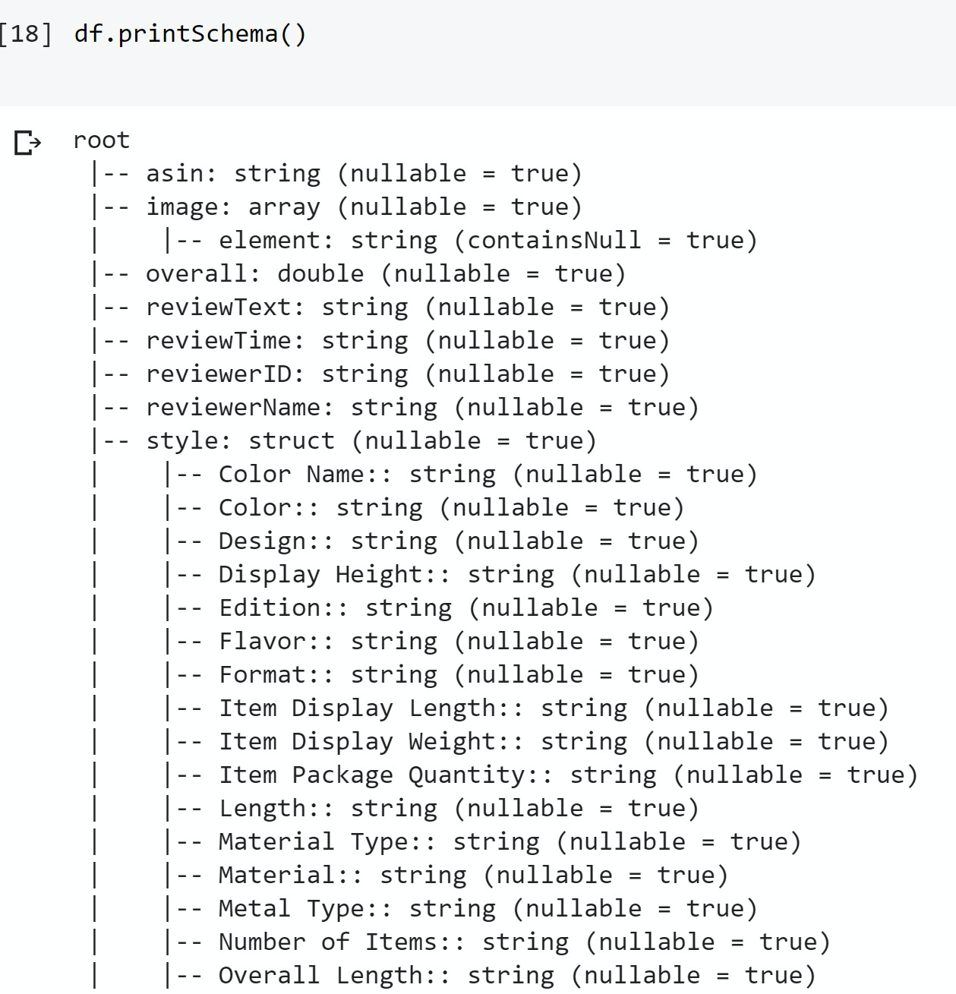
Dataset Schema

Slide 7
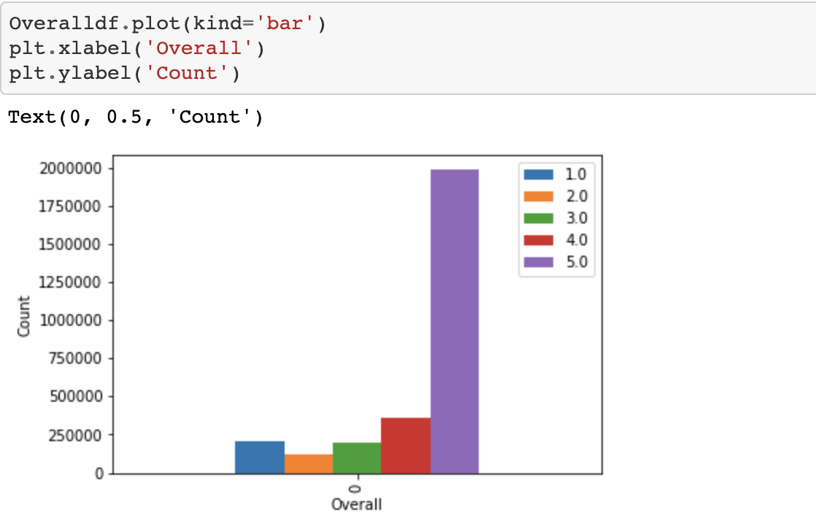
Three steps we used in EDA are:
a.) Graphical Representation of column for overall rating

Slide 8
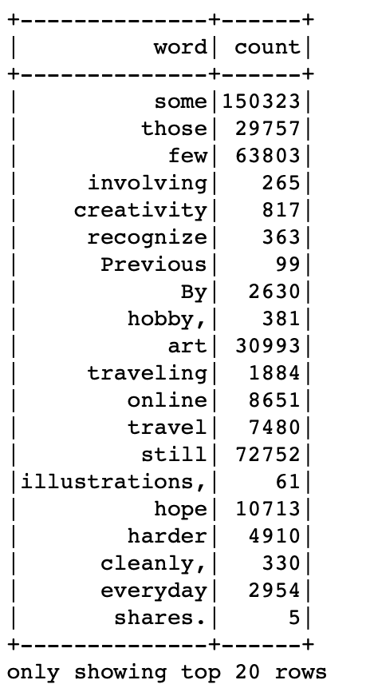
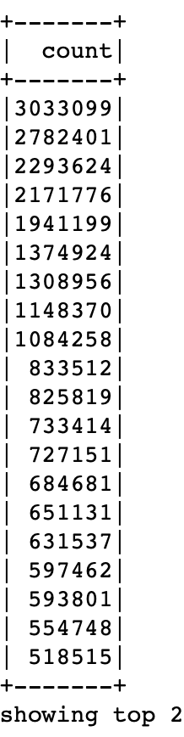
b) Getting the count of most common words

Slide 9
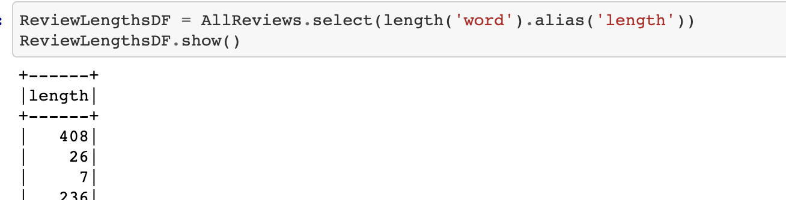
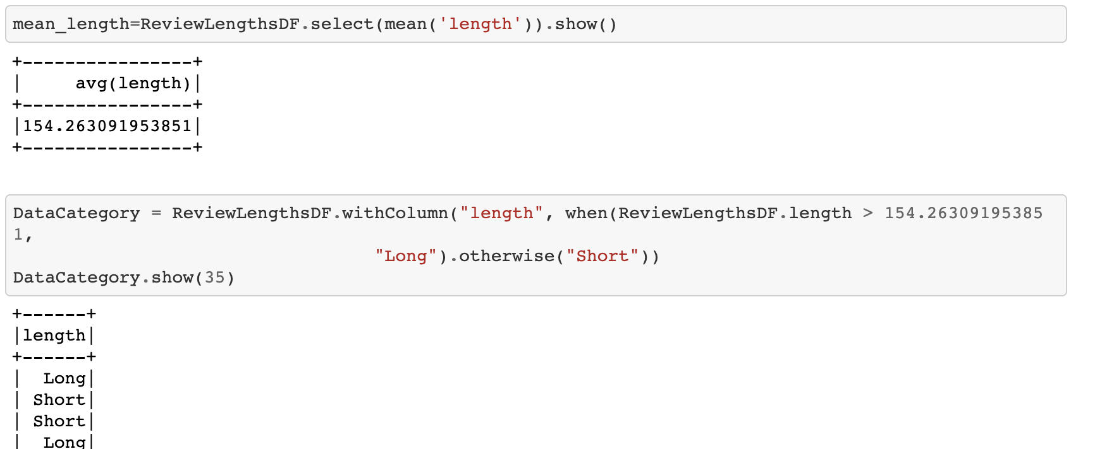
C) Categorizing the length of reviews

Slide 10
3.) Data Processing : For us to perform sentiment analysis we have to concentrate on the Review text column where all the positive and negative feedbacks are given. In order to process this we have to first understand whether data has null values or not, punctuation and removing special characters. Tasks involved
a.) Removing punctations.
b.) Lowercasing words
c.) Removing stopwords

Slide 11
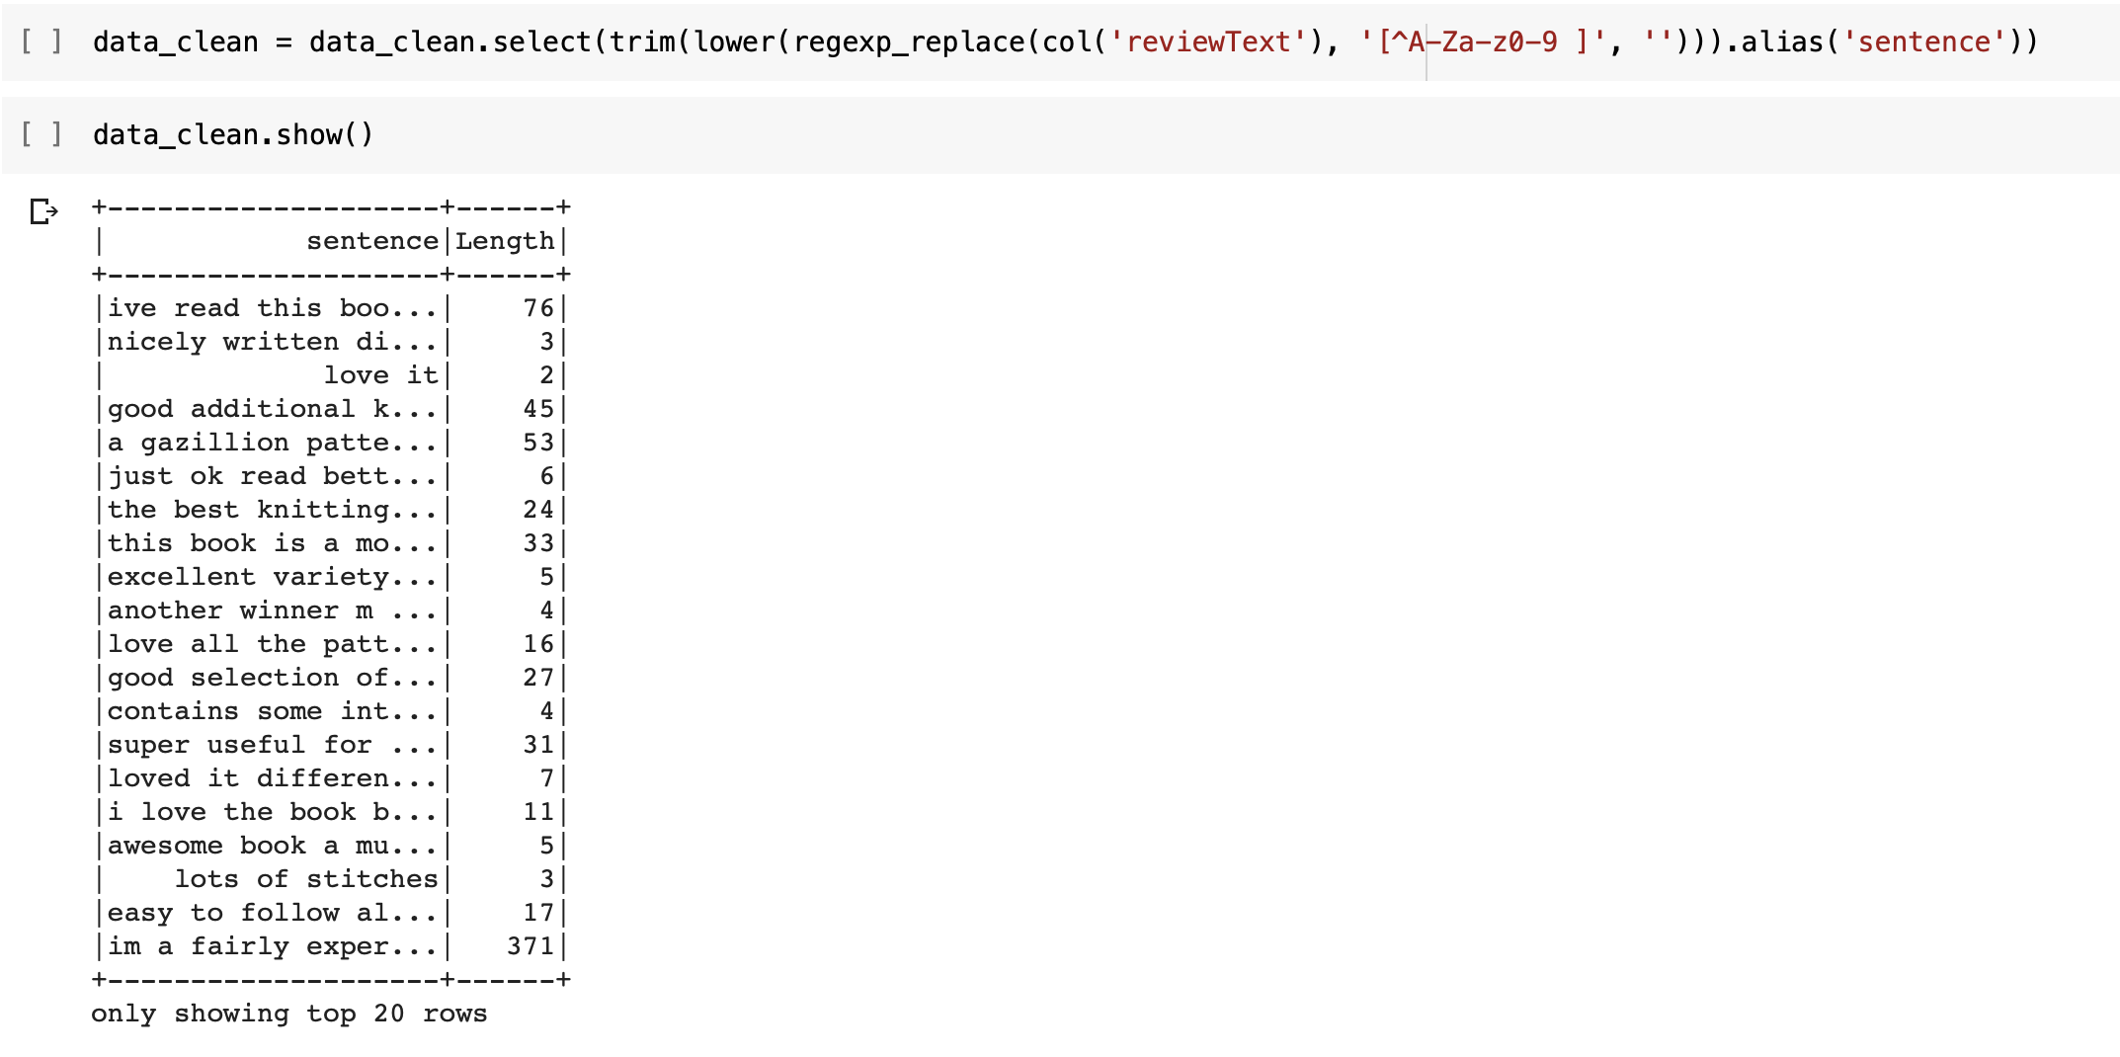
a.) Removing Punctuations &
b.) Lowercasing

Slide 12
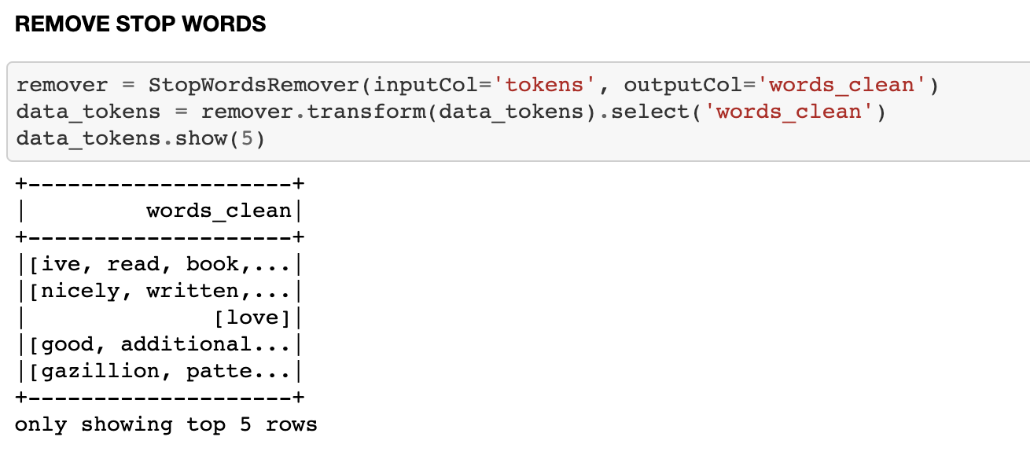
c) Removing Stop words

Slide 13
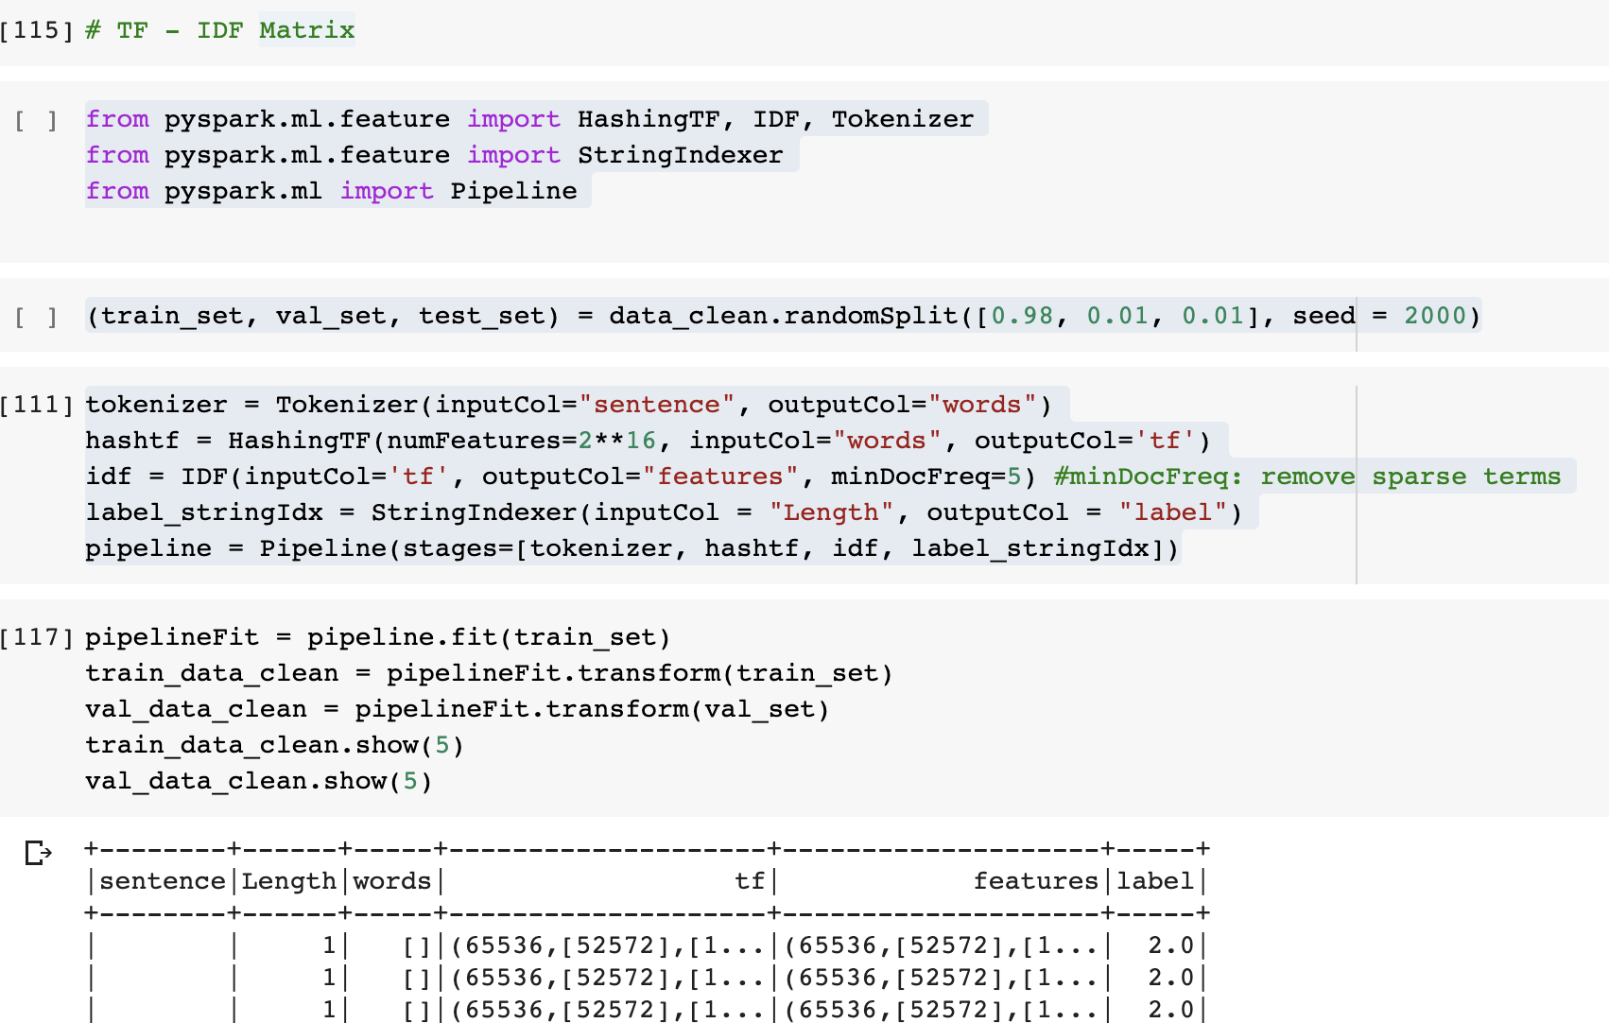
3. Machine Learning
In this part, we created our X and y matrices and apply some algorithms to do NLP tasks. In order to do that, we followed TF-IDF matrix.

Slide 14
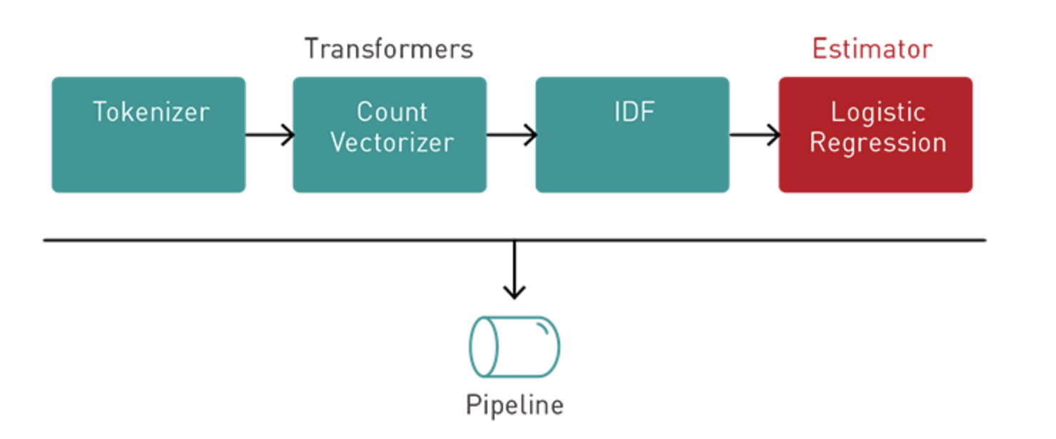
PIPELINE

Slide 15
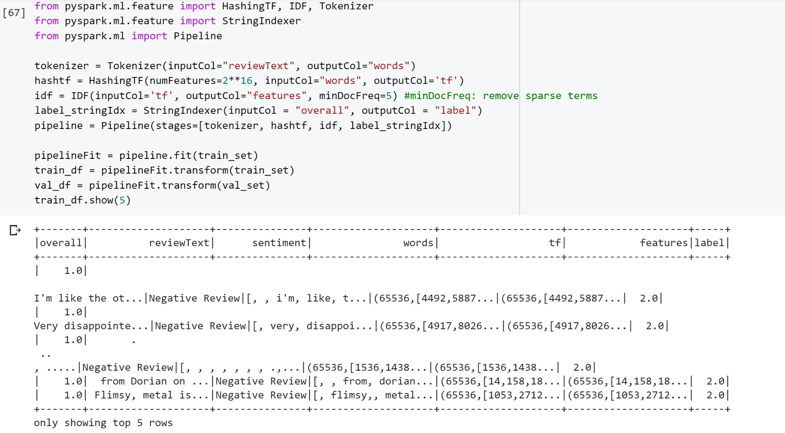
TF - IDF MODEL HashingTF + IDF + Logistic Regression

Slide 16
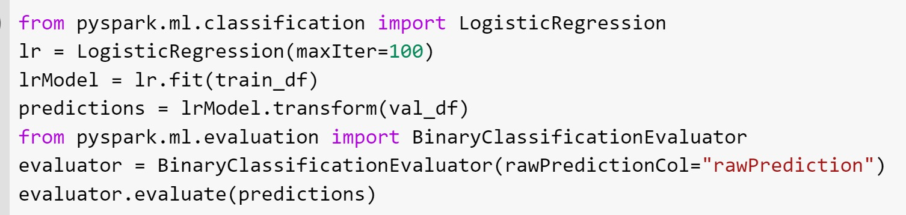
Logistic Regression Model for Prediction

Slide 17
Model Accuracy

Slide 18
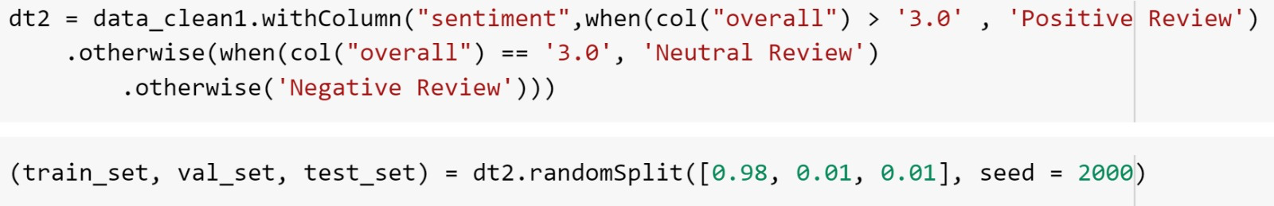
SENTIMENT ANALYSIS

Slide 19
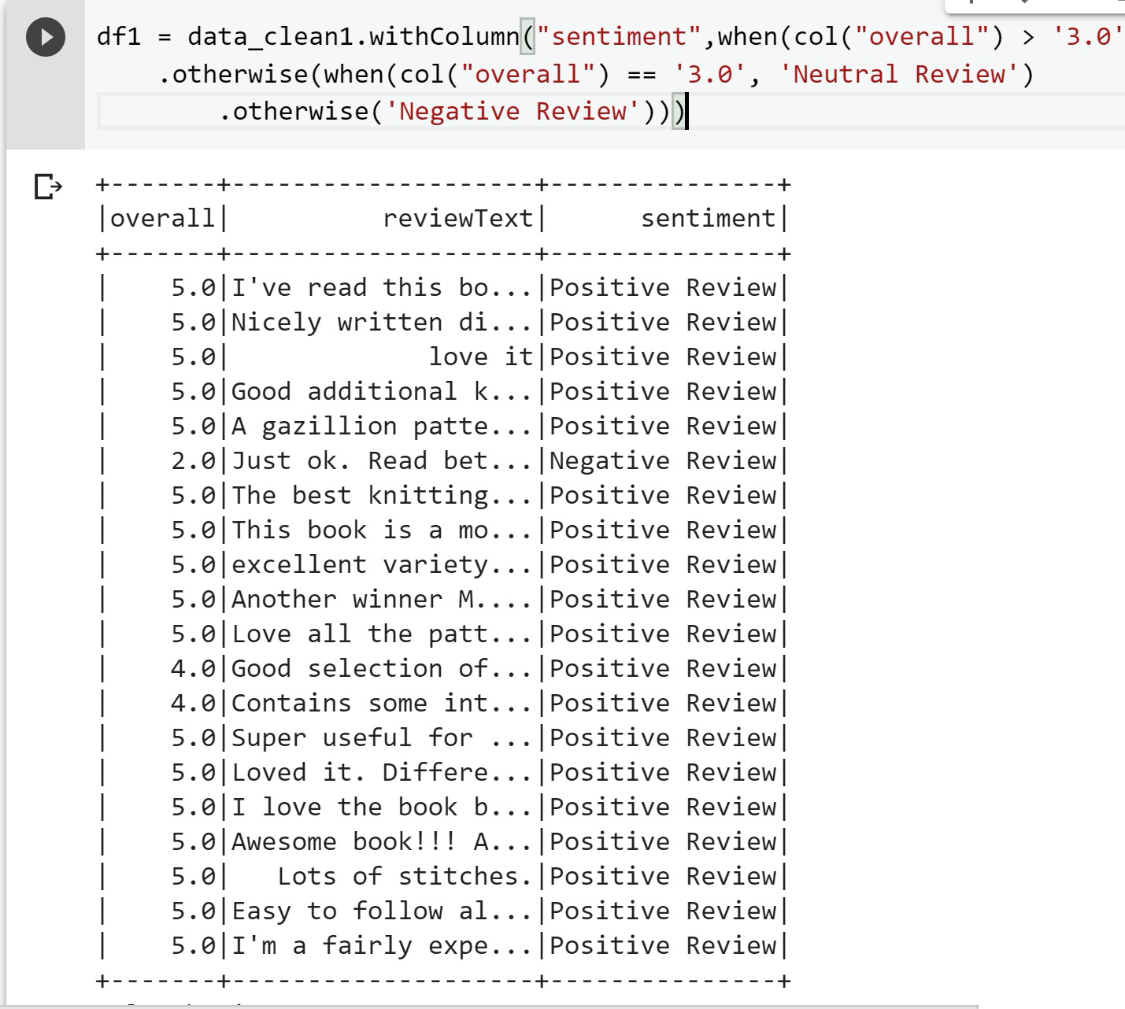
SENTIMENT ANALYSIS OUTPUT

Slide 20
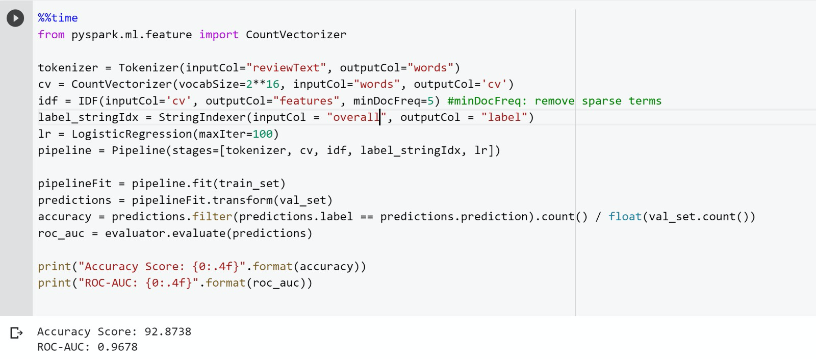
CountVectorizer + IDF + Logistic Regression

Slide 21
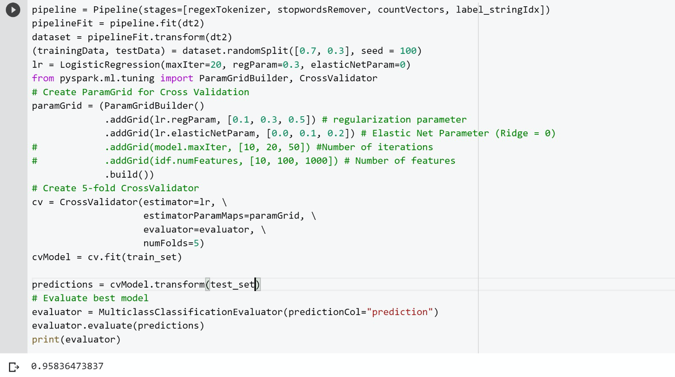
VALIDATION

Slide 22
THANK YOU

